Slide 1

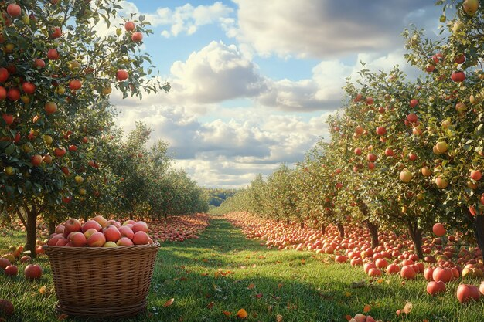
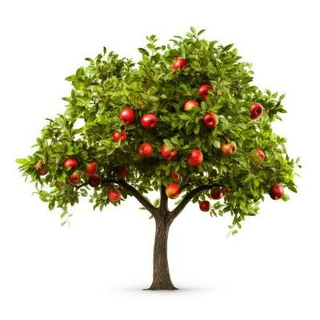
The Potential of a Single Apple
Habakkuk 2:14

Slide 2
The Potential of an Apple
Colossians 1:25-28
Of this church I was made a minister according to the stewardship from God bestowed on me for your benefit, so that I might fully carry out the preaching of the word of God, that is, the mystery which has been hidden from the past ages and generations, but has now been manifested to His saints, to whom God willed to make known what is the riches of the glory of this mystery among the Gentiles, which is Christ in you, the hope of glory. We proclaim Him, admonishing every man and teaching every man with all wisdom, so that we may present every man complete in Christ.

Slide 3


Slide 4
Abide in Christ, and Christ in you
1 John 2:3-6

Slide 5

Abide in Christ

Slide 6
Abide in Christ
True Tressure
1) Personal knowledge about Jesus and of Jesus
2) The gift of righteousness through faith
3) The Power of Christ, living inside us
4) Sharing in Jesus’ sufferings
5) Glory that comes through Jesus’ resurrection

Slide 7
Abide in Christ
People were Asking
1) Were the people who left our church really Christians?
If yes, why did they go?
If no, how can we know who is and is not a Christian?
How can we be sure we really are Christians?

Slide 8
Abide in Christ
Abiding = Obedience Verse 3 – 4
“Knowing” means
  The more we know who God is, the more we will obey Him
  1 John 4:6 & 16
  1 John 3:24
We trust God’s love and His path

Slide 9
Abide in Christ
Abiding = Living Like Jesus Verse 5–6
“The Christian who does not meditate on or keep the law of God should live in constant turmoil.”
John Piper

Slide 10
Abide in Christ
Abiding = Living Like Jesus Verse 5–6
Christians are Obedient Disciples
Obedient Disciples are Christians

Slide 11
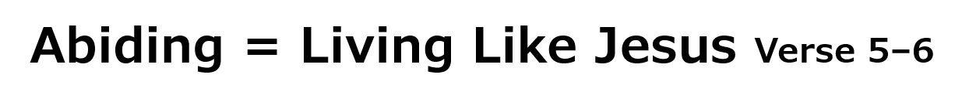
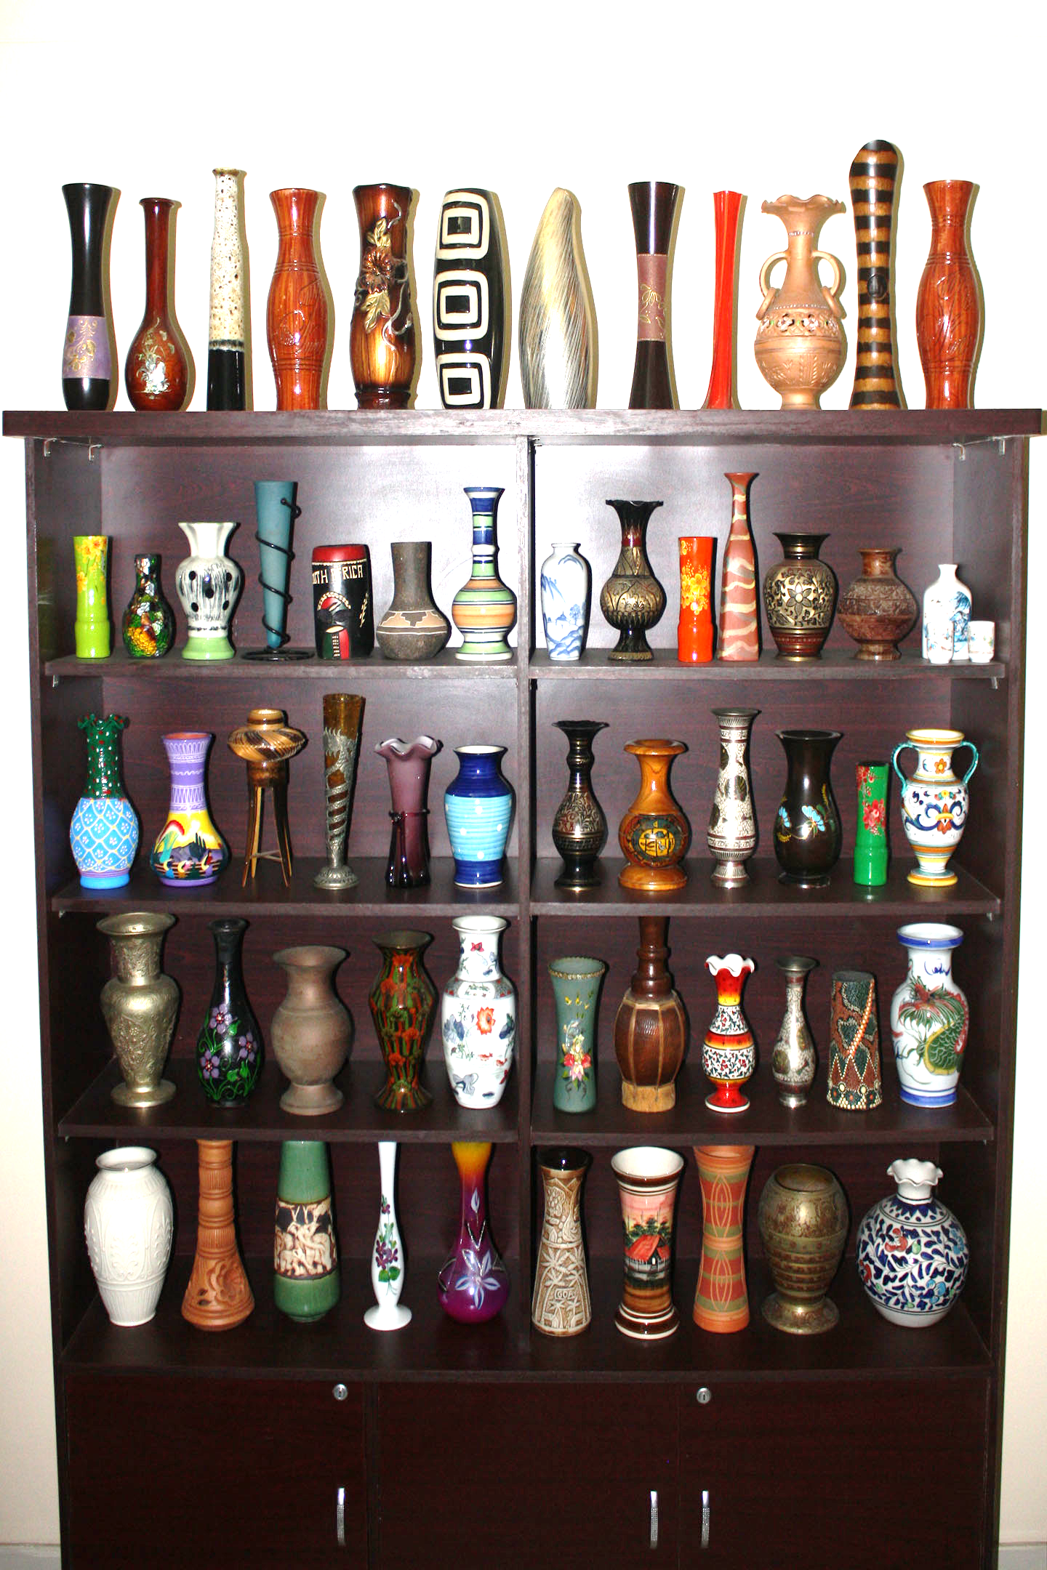
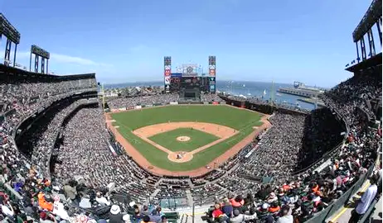
The Potential of an Apple

Slide 12
Abide in Christ
Abiding = Living Like Jesus Verse 5–6
Psalm 63:1
John 15:10
John 14:23

Slide 13
Abide in Christ
Abiding = Assurance of Salvation
John 15
  Vine Dresser’s Work
  The Believer’s Work
Attitude Fruit
Action Fruit

Slide 14
Abide in Christ
Abiding = Assurance of Salvation
Personal Devotions
Personal Prayer

Slide 15
Abide in Christ
Praying for…
A. C. T. S.
People to worship Him
Schools that educate children
Well-functioning families
Government and businesses that serve
Open hearts and open homes

Slide 16
Abide in Christ
Abiding in Christ involves:
Submission to His authority
and
(2) Compliance with His desires and commands
An attitude of the heart and
a way of life

Slide 17
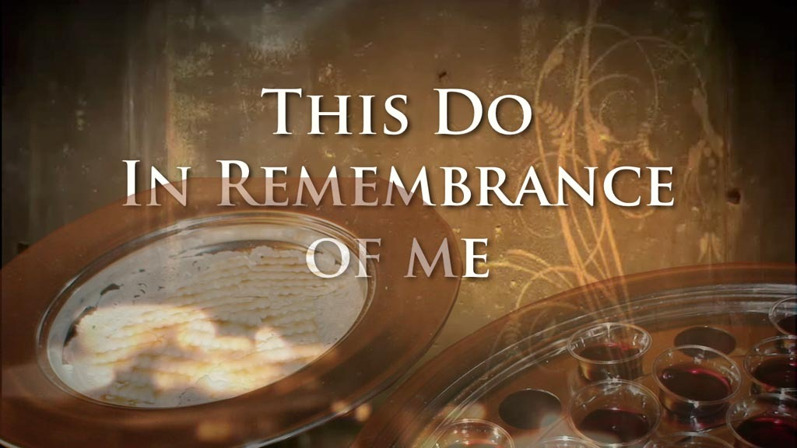
Unity around the Table

