Slide 1


Slide 2
The Incarnation: God Became Man
1 John 1:1-4

Slide 3
The Incarnation
Your Greatest Weakness
is
Your Strength Misdirected

Slide 4


Slide 5
The Incarnation
Outline
God Became Human (1-2)
God Became Human with Us in Mind
God Became Human to Unite Us (3-4)

Slide 6
The Incarnation
(1) God Became Human (1-2)
  And the Word became flesh, and dwelt among us, and we saw His glory, glory as of the only begotten from the Father, full of grace and truth.
  John 1:14

Slide 7
The Incarnation
(1) God Became Human (1-2)
  For by Him all things were created, both in the heavens and on earth, visible and invisible, whether thrones or dominions or rulers or authorities —all things have been created through Him and for Him. He is before all things, and in Him all things hold together.
  Colossians 1:16-17

Slide 8
The Incarnation
(1) God Became Human (1-2)
  And the testimony is this, that God has given us eternal life, and this life is in His Son. He who has the Son has the life; he who does not have the Son of God does not have the life.
  1 John 5:11-12

Slide 9
The Incarnation
(1) God Became Human (1-2)
  He who believes in the Son has eternal life; but he who does not obey the Son will not see life, but the wrath of God abides on him.
  John 3:36

Slide 10
The Incarnation
(2) God Became Human with Us in Mind
John 1:14
Luke 1:35
Now the birth of Jesus Christ was as follows: when His mother Mary had been betrothed to Joseph, before they came together she was found to be with child by the Holy Spirit.
Matthew 1:18

Slide 11
The Incarnation
(2) God Became Human with Us in Mind
  Have this attitude in yourselves which was also in Christ Jesus, who, although He existed in the form of God, did not regard equality with God a thing to be grasped, but emptied Himself, taking the form of a bond-servant, and being made in the likeness of men.

Slide 12
The Incarnation
God Became Human with Us in Mind
  Being found in appearance as a man, He humbled Himself by becoming obedient to the point of death, even death on a cross.
  Philippians 2:5-8

Slide 13
The Incarnation
God Became Human with Us in Mind
  These things I have spoken to you, so that in Me you may have peace. In the world you have tribulation, but take courage; I have overcome the world.
  John 16:33

Slide 14
The Incarnation
God Became Human with Us in Mind
  For what the Law could not do, weak as it was through the flesh, God did: sending His own Son in the likeness of sinful flesh and as an offering for sin, He condemned sin in the flesh
  Romans 8:3

Slide 15
The Incarnation
God Became Human with Us in Mind
  yet He has now reconciled you in His fleshly body through death, in order to present you before Him holy and blameless and beyond reproach
  Colossians 1:22

Slide 16
The Incarnation
God Became Human with Us in Mind
Why the Incarnation?
  So we could become divine
  To destroy the power of sin and death

Slide 17
The Incarnation
(3) God Became Human to Unite Us (3-4)
1st – Fellowship with God
2nd – Fellowship with Others
We are Ambassadors
True Fellowship is Centered on King Jesus, the Son of God

Slide 18
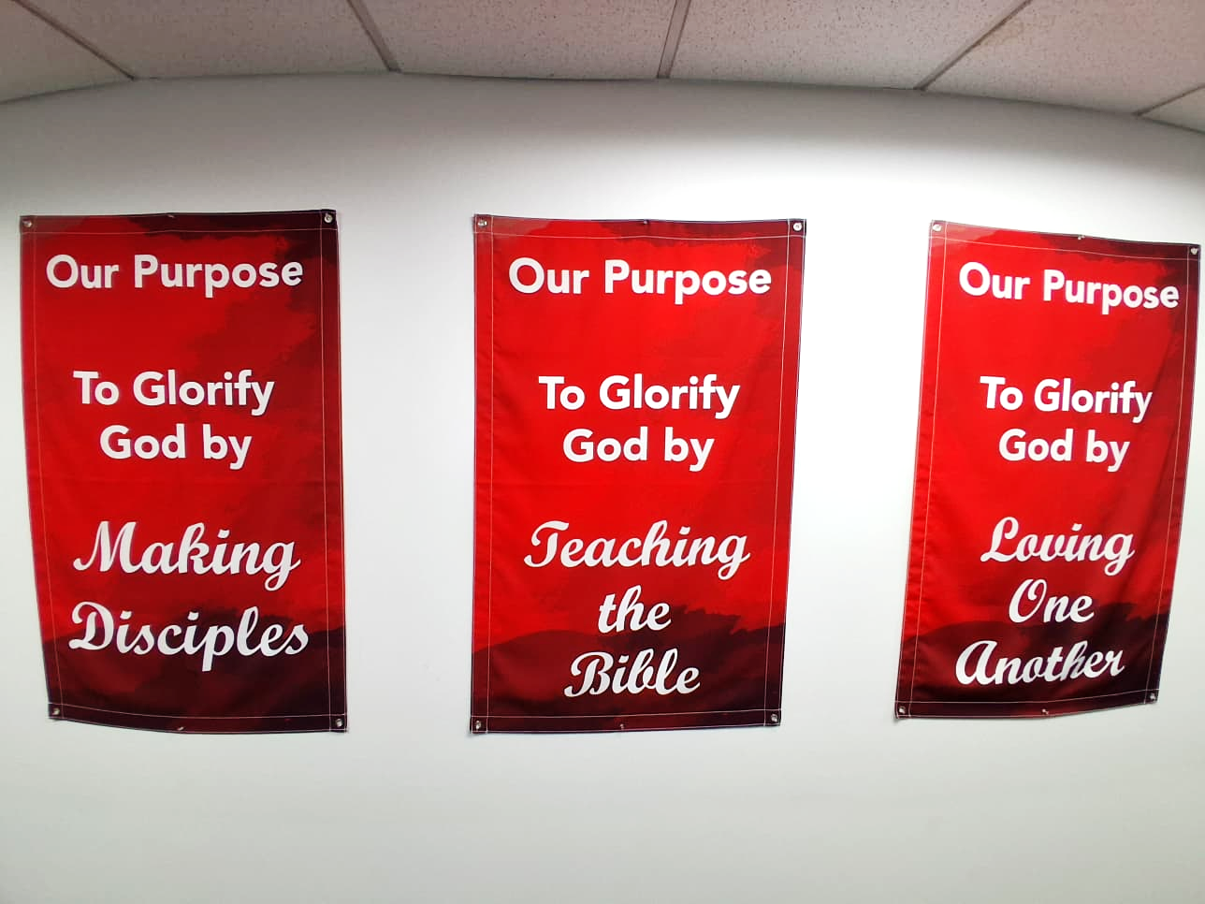
The Incarnation
(3) God Became Human to Unite Us (3-4)

Slide 19
The Incarnation
Application
Your Greatest Weakness
is
Your Strength Misdirected
What is your redirected story?

